Slide 1
Finding out Good Places
to Open the New Restaurant
Dong-Yeong Kim
As of 18 Jan, 2021

Slide 2
Introduction
· Why the restaurant?
In my country, South Korea, self-employment is more common way than other countries. In 2019, 25% of Korean are self-employed, and this percentage is higher than Japan(10%), US(6%), and OECD average(15%).
The self-employed usually consider first to open a restaurant or café, but in many cases they do not have know-how or strategy for their business.
→ It will be helpful who consider to newly open their own restaurant, or who want
to handle the labor/economic problem related to this problem.

Slide 3
Data
· Sources
- Number of famous restaurants near the each station(from Foursquare)
: I use the 'explore' endpoint to count only 'famous' restaurants
- User number(of Nov 20) and location data of the each station
(from Seoul Metropolitan Government)
· Cleaning and Selection
- It was cleaned well, so I just dropped some columns not to be used
(Station ID number, data collection date, …)
and merged them into one dataframe.

Slide 4
Data
· Exploratory Analysis
- I determined to use linear regression when I saw the scatter plot of the datasets,
because it seems there is positive correlation between the user number
and the famous restaurant number near each station.
- Also, there is no cluster except the area between (0,0) to (1000, 20).
So I expected there is no meaningful results if I use classification or clustering.

Slide 5
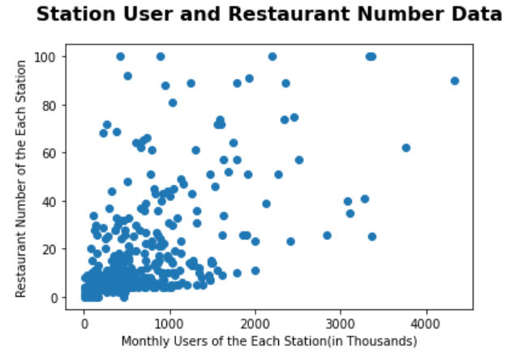
Data
· Scatter Plot

Slide 6
Methodology & Results
· Primise
- There is positive correlation between sales of the restaurant
and the floating population. And the floating population is critical factor to sales.
· Linear Regression
- Used all data as trainset, because I think I cannot use this results as prediction tool, and just be able to use it as describing tool for current status.

Slide 7
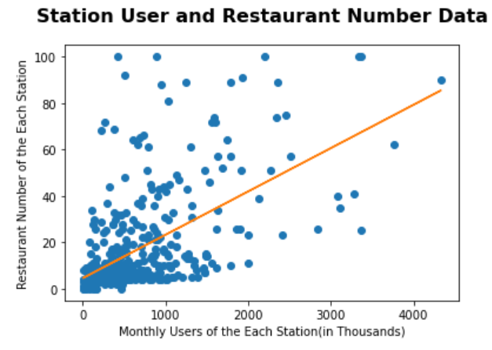
Methodology & Results
· Linear Regression Result : y = 0.0187X + 4.5950

Slide 8
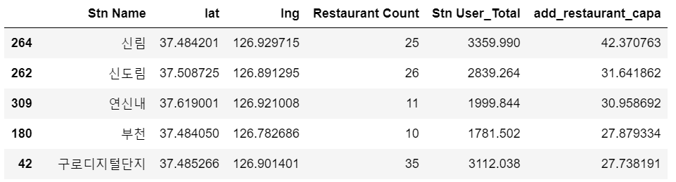
Methodology & Results
· Discussion
- I defined 'restaurant capability,’ as subtracting real restaurant number
from prediction, and it means the number of additional stores that can be opened,
considering the average.
- According to the restaurant capability, there are some good places to open
the new restaurant, such as ‘신림’, ‘신도림’, and so on(see below).

Slide 9
Conclusion
· There are some ‘outstanding’ places to open the new restaurant,
according to the result of this project.
· But also, there are some blind spots as below.
So, next time I will try to fix these defects.
- Did not consider other variables(rent, purchasing power of Floating population)
- Koreans usually use other applications(Naver Maps, Kakao Maps, etc.),
not Foursquare, so the data about popular restaurants may be distorted.

Slide 10
Thank you!

